Slide 1
AIT 736 Applied Machine Learning (Fall 2024)
Project: Demonstration & Presentation

Slide 2
Cats vs Dogs Classification using CNN Python Keras
Group Information
Group Number - 4
Group Members:
Praneeth Ravirala (G01448129)
Shalvi Sanjay Lale (G01419005)

Slide 3
Introduction
This Presentation discusses the following topics:
Introduction to CNN
Proposed System Architecture
Model Performance
GUI Design
Visualizing Results
Challenges
Learnings and Future Scope
The Aim of the Project is to build a Convolutional Neural Network which classifies the Image that contains a dog or a cat, deploy the trained model using Graphical User Interface

Slide 4
Hardware and Software Requirements
Hardware:
RAM: 15GB
GPU RAM: 15GB
HardDisk: 4GB
Operating System: Windows, MacOS, Linux
Processor: Intel, Apple Silicon
Software:
Programming Language: Python
Tools: Jupyter Notebook, Google Collab
Libraries: Numpy, Keras, TensorFlow, Scikit-Learn, Tkinter

Slide 5
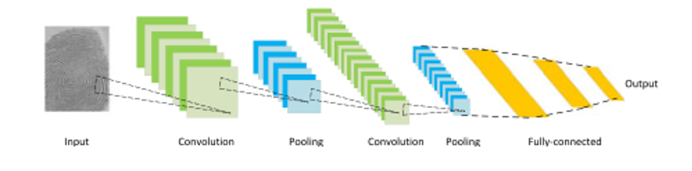
Introduction to CNN
CNN will generally have the below steps:
The image is sent in as an input
It is then passed through convolution layer, which applies features to create a matrix
It is then passed through pooling layer, which reduces the size of the matrix and applies activation function
The image might be passed several times through these layers
Finally, it is passed through fully connected layer, where it is flattened in a 1-D vector and the output is categorized

Slide 6
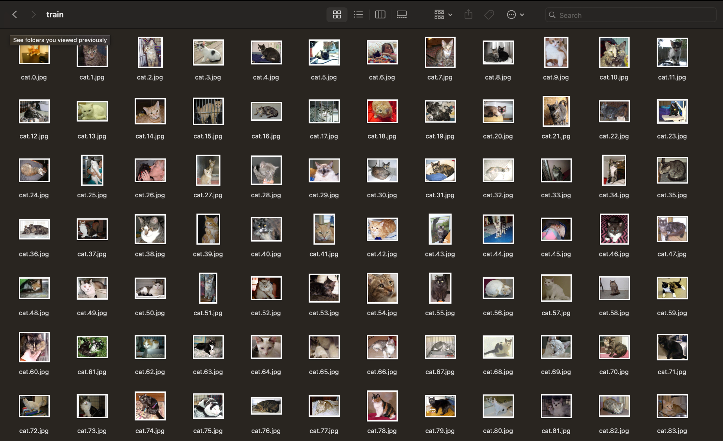
About Dataset
Dataset Name: ‘Cats vs Dogs’
Dataset is taken from Kaggle
It contains images of different types of cats and dogs in different backgrounds
All Images are of variable pixel dimensions
All Images have ‘RGB’ color space

Slide 7
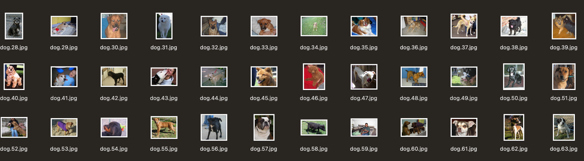
About Dataset
Dataset was split into Train, Test and Validation sets with each containing following no of images:
Train: 16000
Validation: 4000
Test: 5000

Slide 8
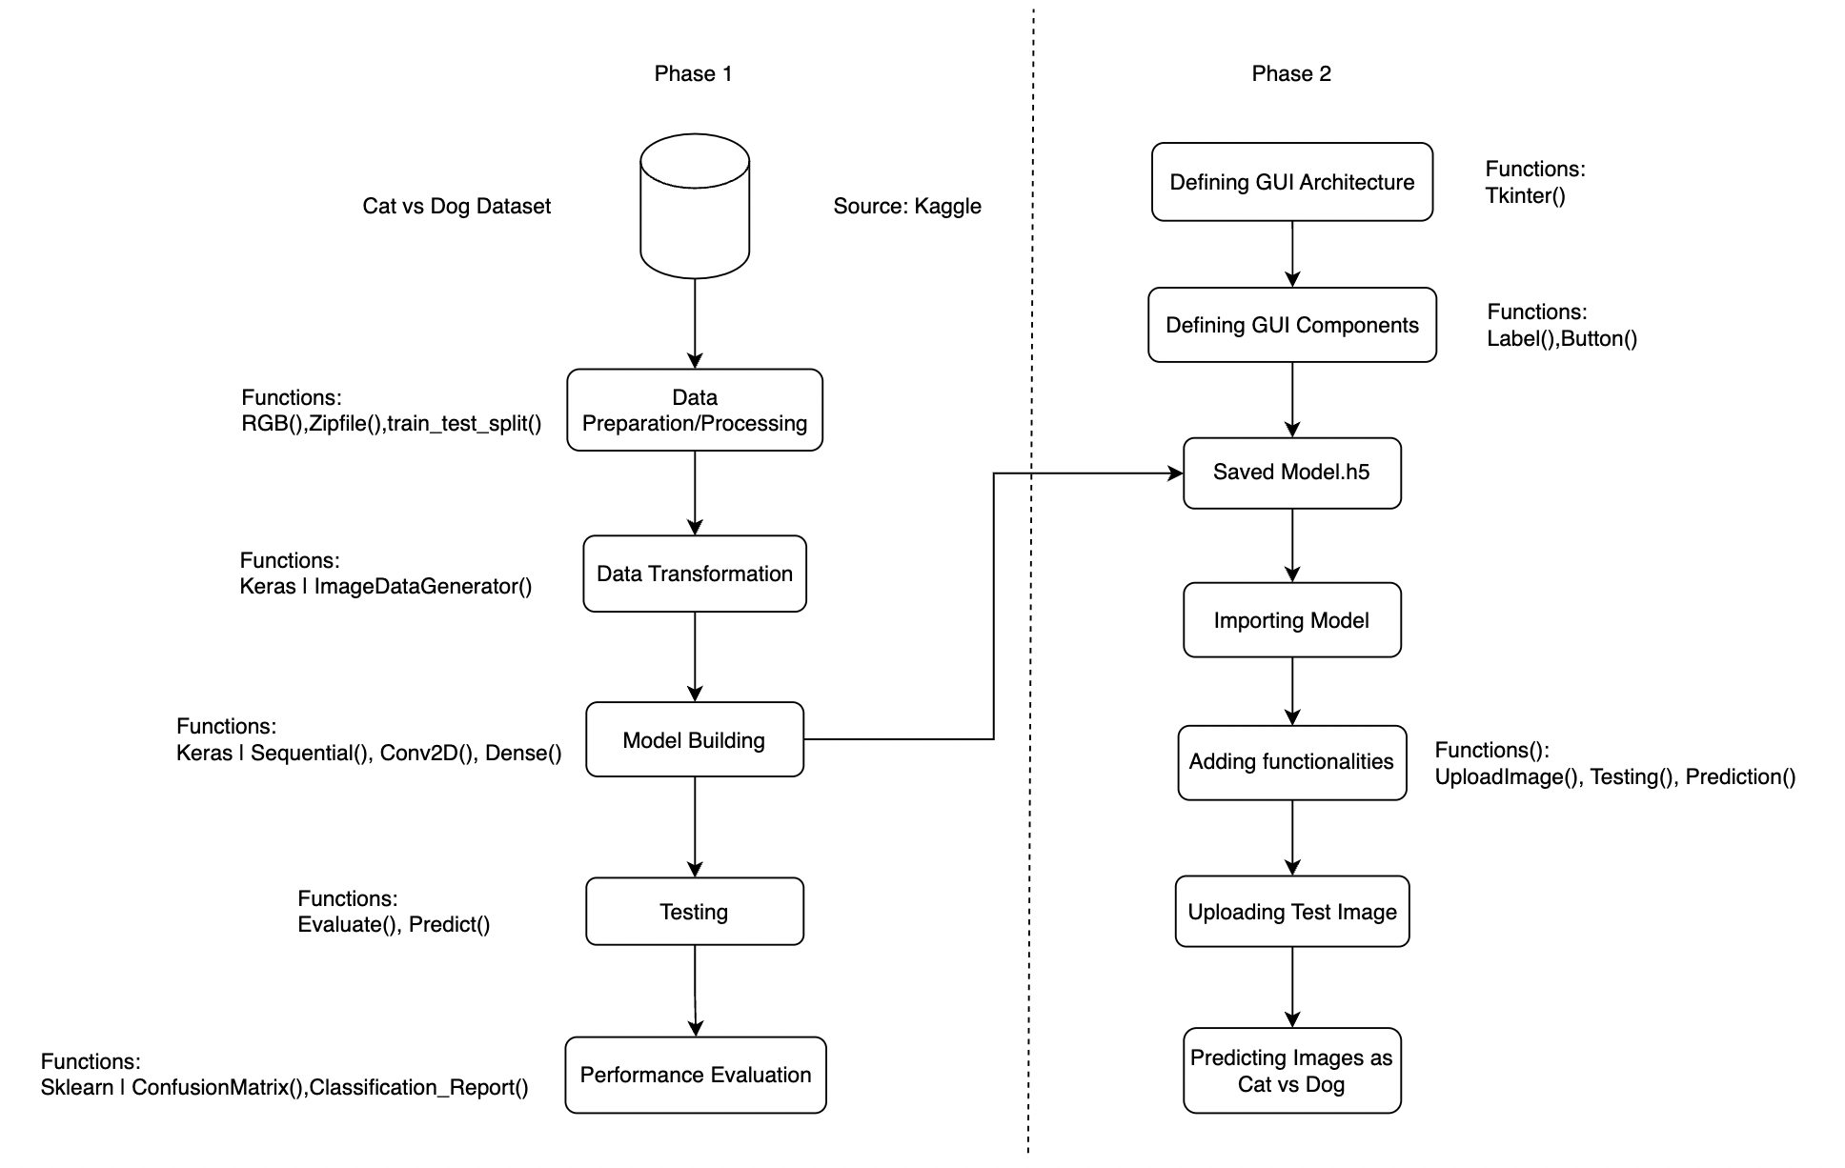
Proposed System Architecture

Slide 9
Proposed System Architecture
The Project is divided into two phases:
Phase1:
Data Preparation/Preprocessing
Data Transformation
Defining Model Architecture
Model Building
Classification and Performance Evaluation

Slide 10
Proposed System Architecture
Phase 2:
Defining GUI Structure
Placement of required GUI Components
Importing Trained Model to the Architecture
Defining functionalities to work interactively with the model
Import test image to the architecture
Predict the image as Cat or a dog

Slide 11
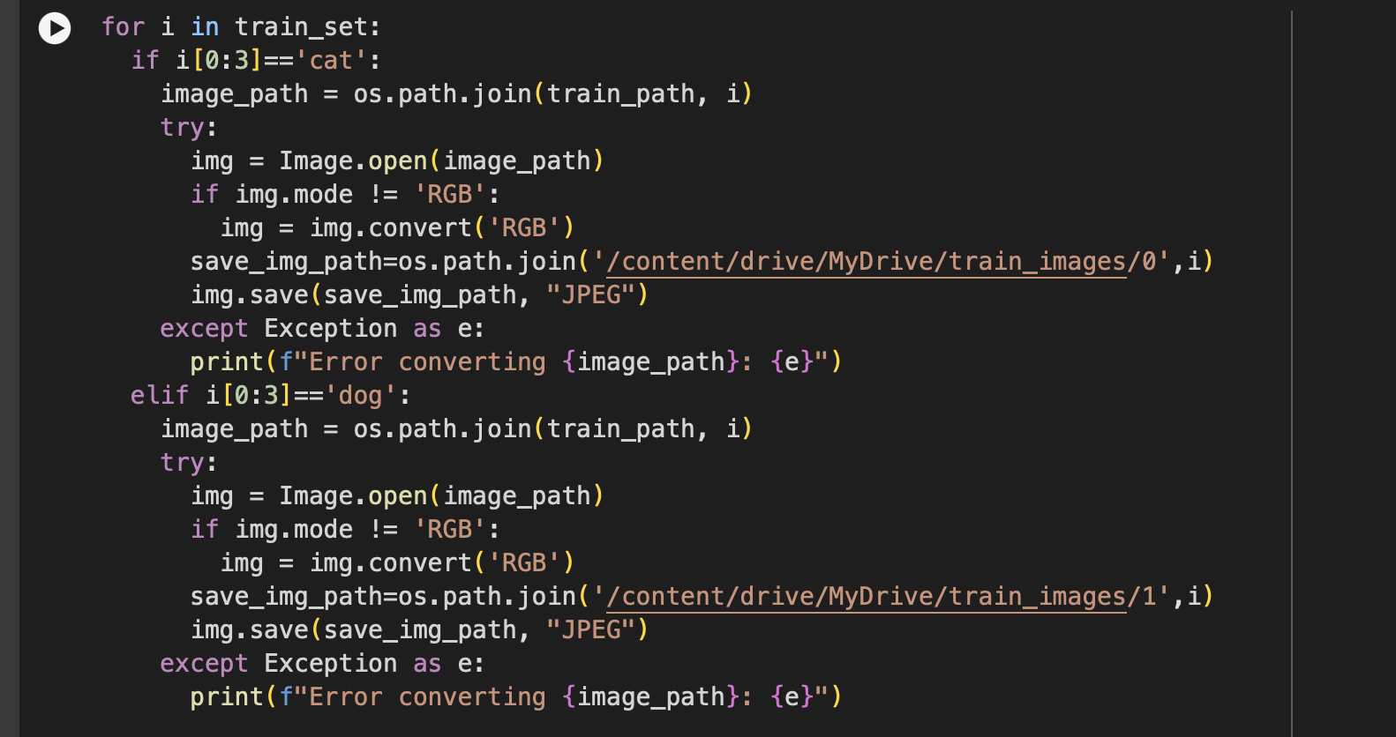
Data Preprocessing
Importing the Dataset
Checking all the images are of valid file type eg: .jpg or .JPEG or .PNG
Splitting the Dataset into Training Validation and Testing
Converting all the images into RGB mode
Dividing Images into subdirectories of corresponding class ‘Dog:1’ or ‘Cat:0’
Resizing the Images to 128x128 Pixel dimension.

Slide 12
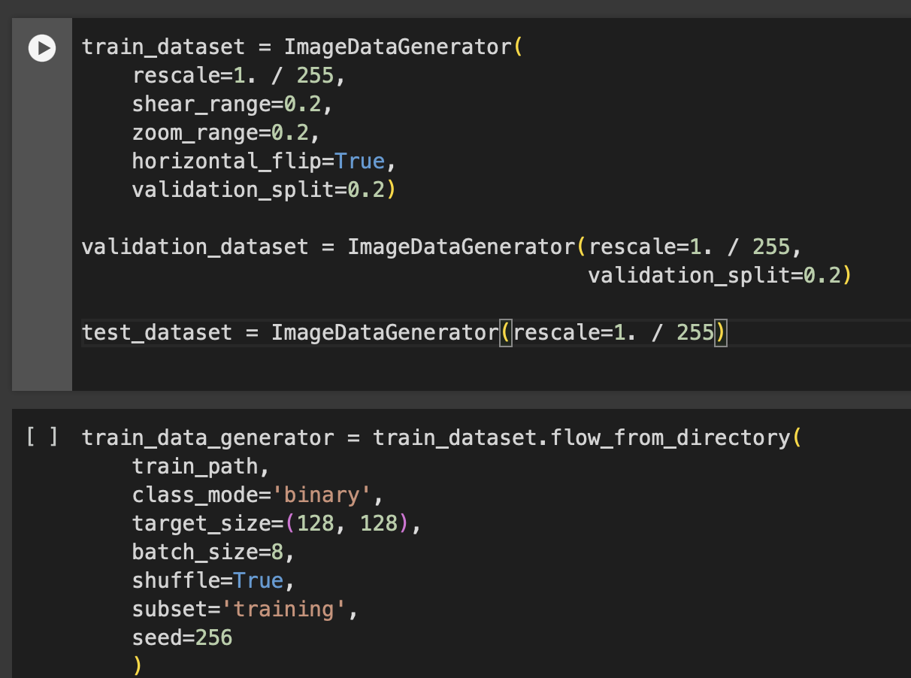
Data Transformation
Applied Image Augmentation Techniques Such as:
Shear = 20%
Zoom = 20%
Horizontal Flip = Yes
Transforming Images to structured data containing numerical values
Normalising the Numerical values into the scale of 0 to 1
After Transformation, data has been divided into batches of size 8 for training.

Slide 13
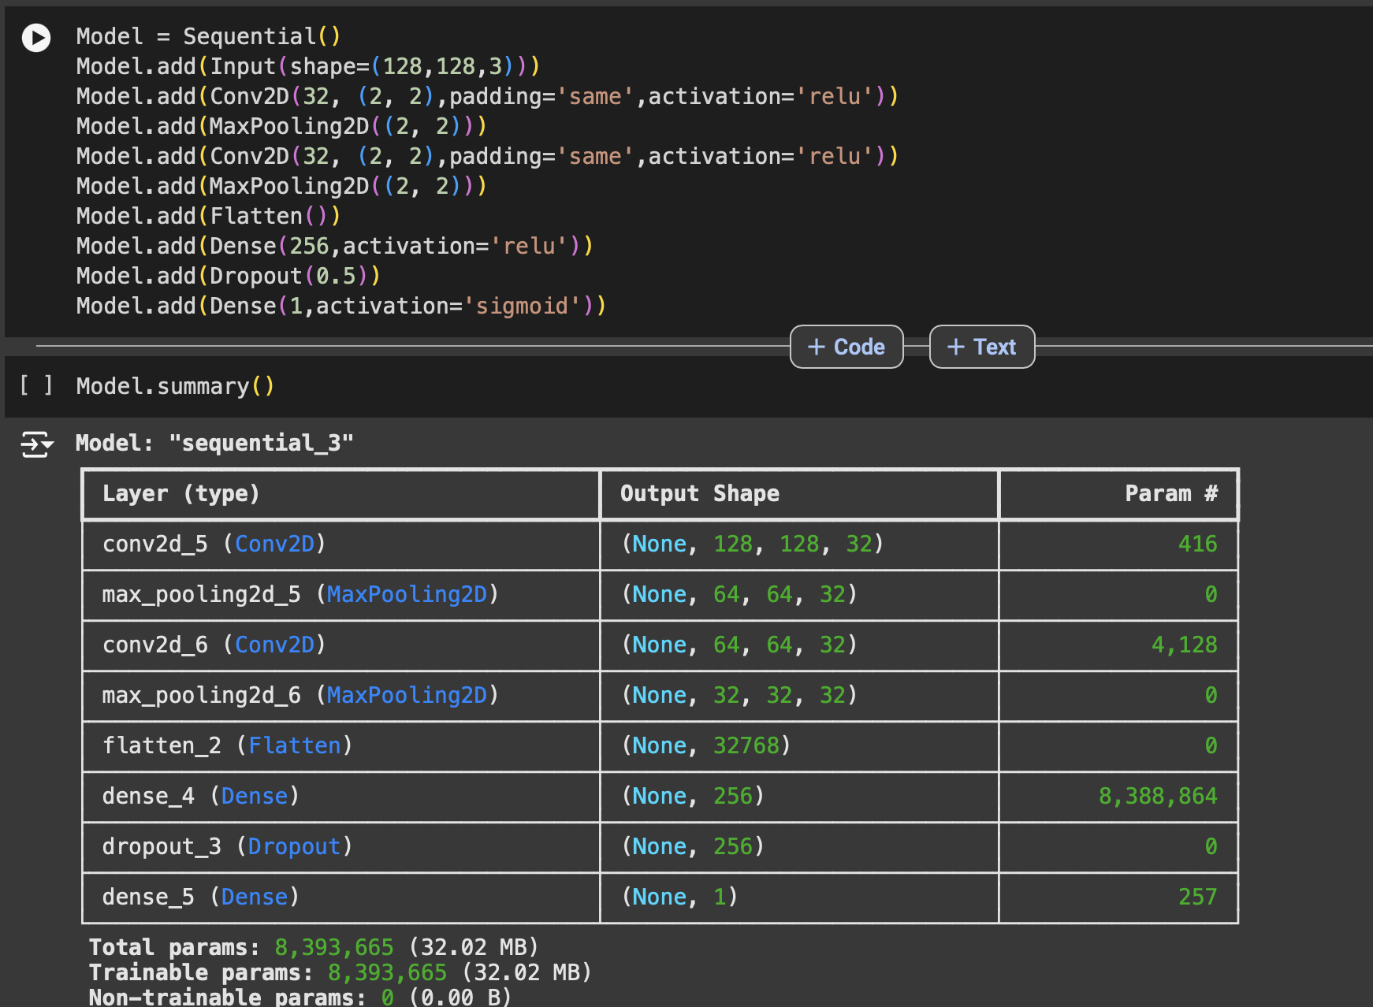
Model Architecture
Defining Sequential Model from Keras Library and Adding the following components:
Input layer with matching input image size of 128x128
2 Convolutional Layers with 32 filters and 2x2 Window size
2 Max Pool layers with 2x2 window size
1 Flatten Layer that converts into 1D Vector
Dropout Function with 0.5 factor
Dense Layer with 256 Neurons

Slide 14
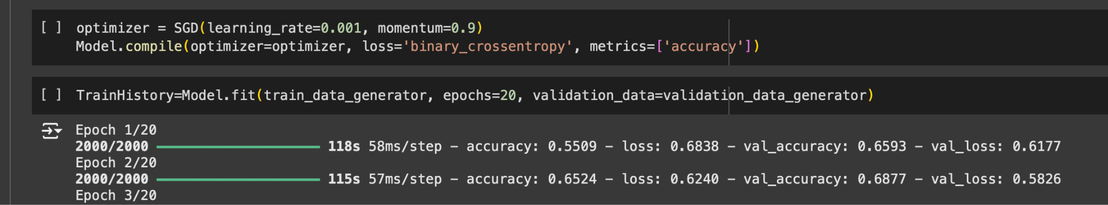
Model Building
The data suitable for training and validation is generated by keras ImageDataGenerator() function.
For Model Building following components are defined:
Stochastic Gradient Descent Optimizer
Learning rate as 0.001
Cross Entropy as Loss Function
Number Training Epochs as 20
All the above parameters are given to Model.fit() function for training.
Training & Validation Accuracies and Loss are Retrieved for Montioring Underfitting or Over Fitting Issues

Slide 15
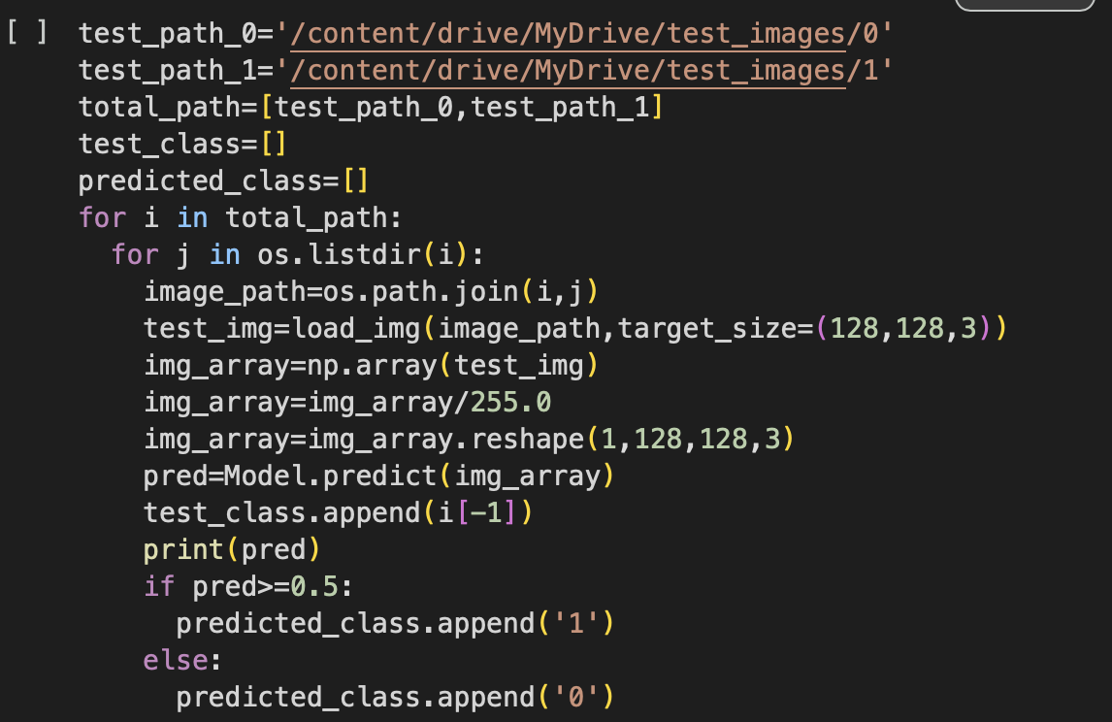
Testing
Using OS library we iterate through Images in test dataset using for loop
Using keras load_img() we resize the image based on input size
Using np.array() we retrieve structured values of images and normalise values in between 0 and 1
Using Model.predict() function we predict the probabilities
We keep cutoff value to 0.5, if probability >= 0.5 it is classified to ‘Dog’, else ‘Cat’

Slide 16
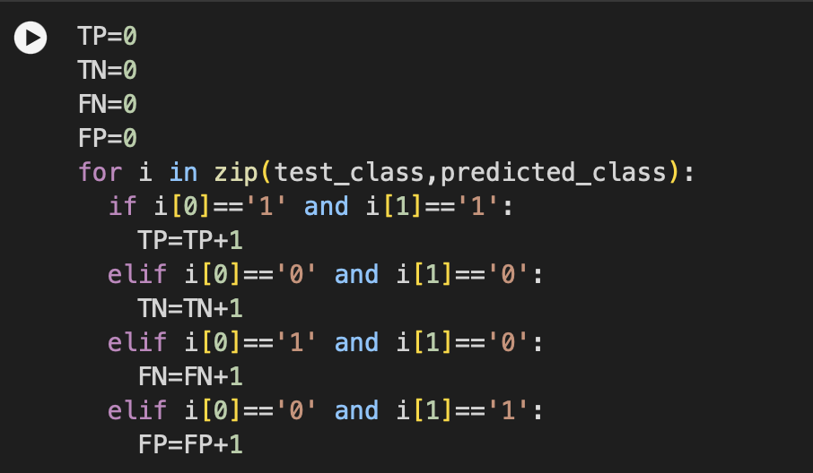
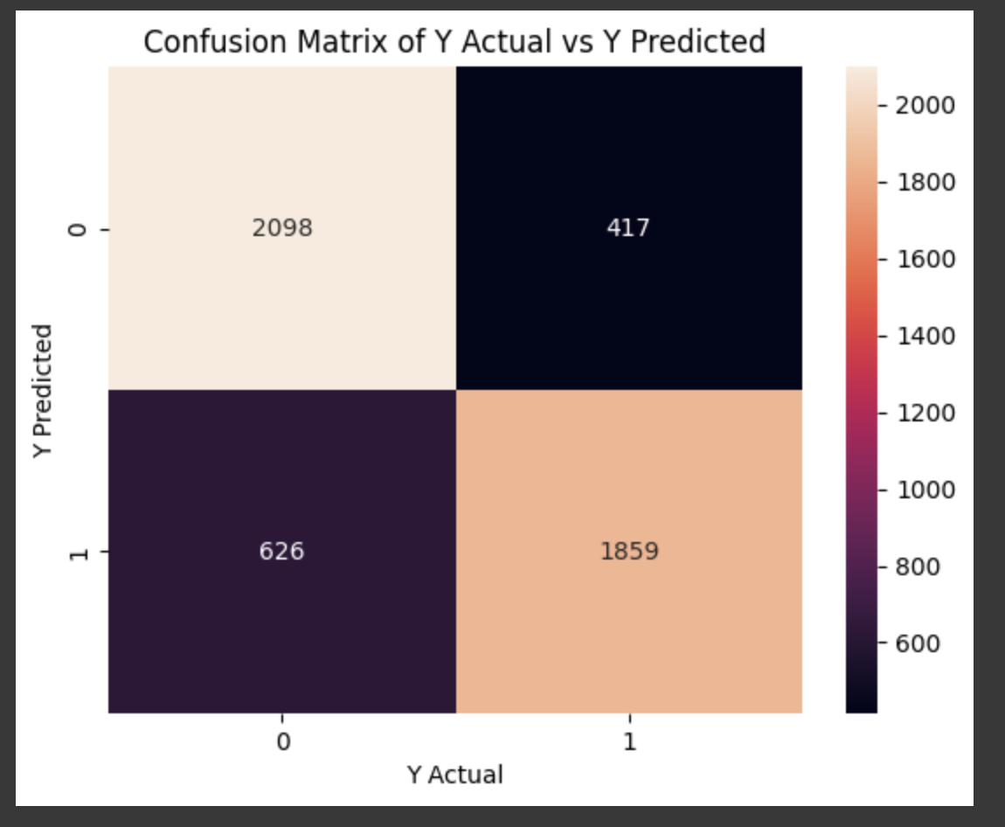
Model Performance
Using Ground Truth and Predicted Labels we calculate TP,FP,TN,FN
To depict model’s performance we retrieve accuracy, precision, recall and f1 score values
Using sklearn.metrics we retrieve classification report and confusion matrix
We visualise these results using matplotlib.

Slide 17
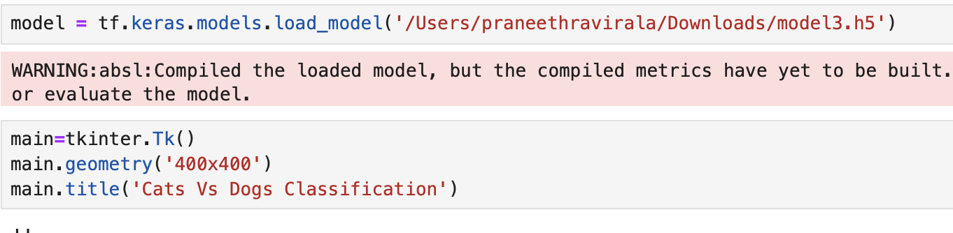
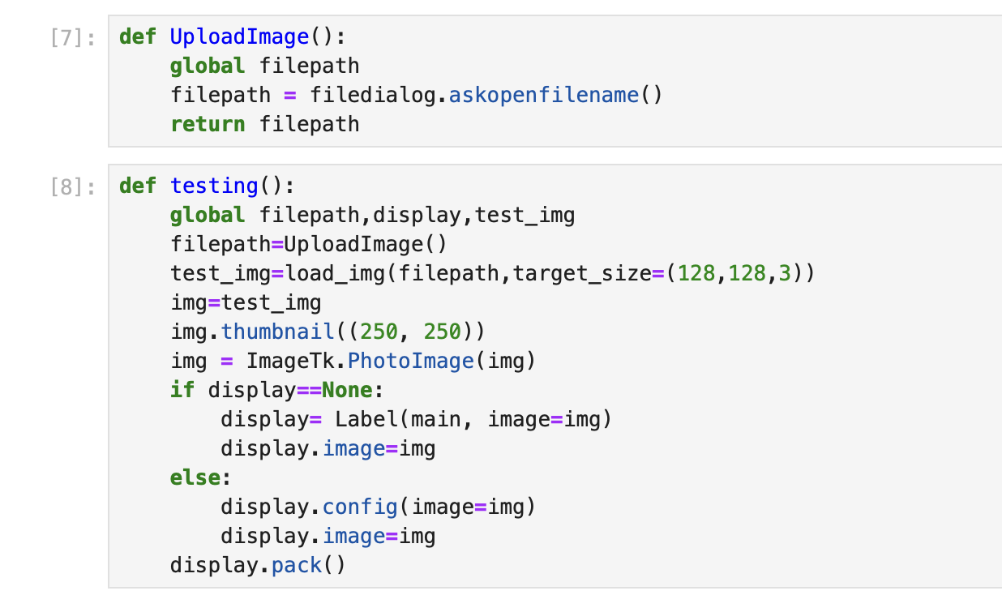
GUI Design
Using Tkinter Library we define GUI architecture
We set structure size 400x400 pixels
We add GUI components such as Labels for adding text or Image elements, buttons for invoking functions.
Adding functionalities such as upload Image, testing and prediction to make UI interactive

Slide 18
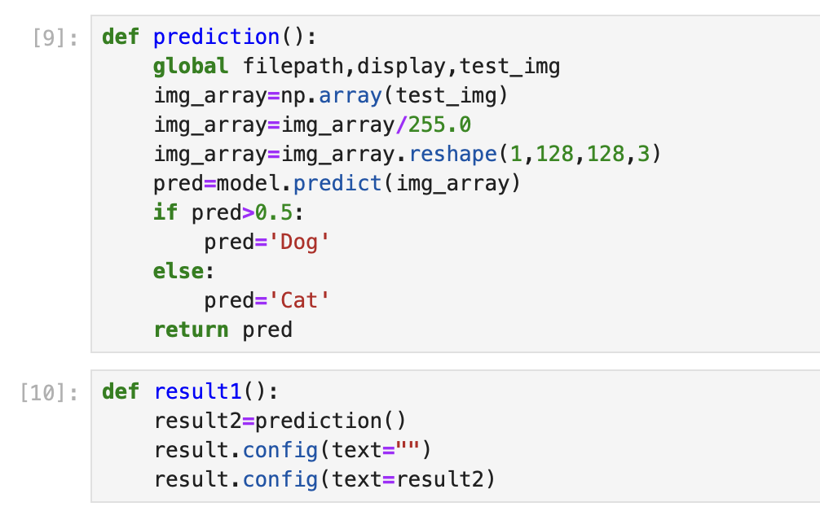
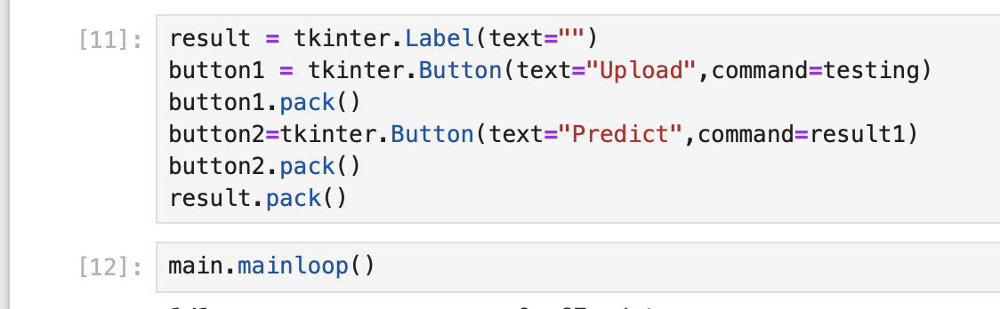
GUI Design
Importing Trained CNN model into the prediction functionality
Uploading the Test Image and classifying the image using model.predict()
Integrating the functionalities with components so that image and predicted label is displayed on GUI.

Slide 19
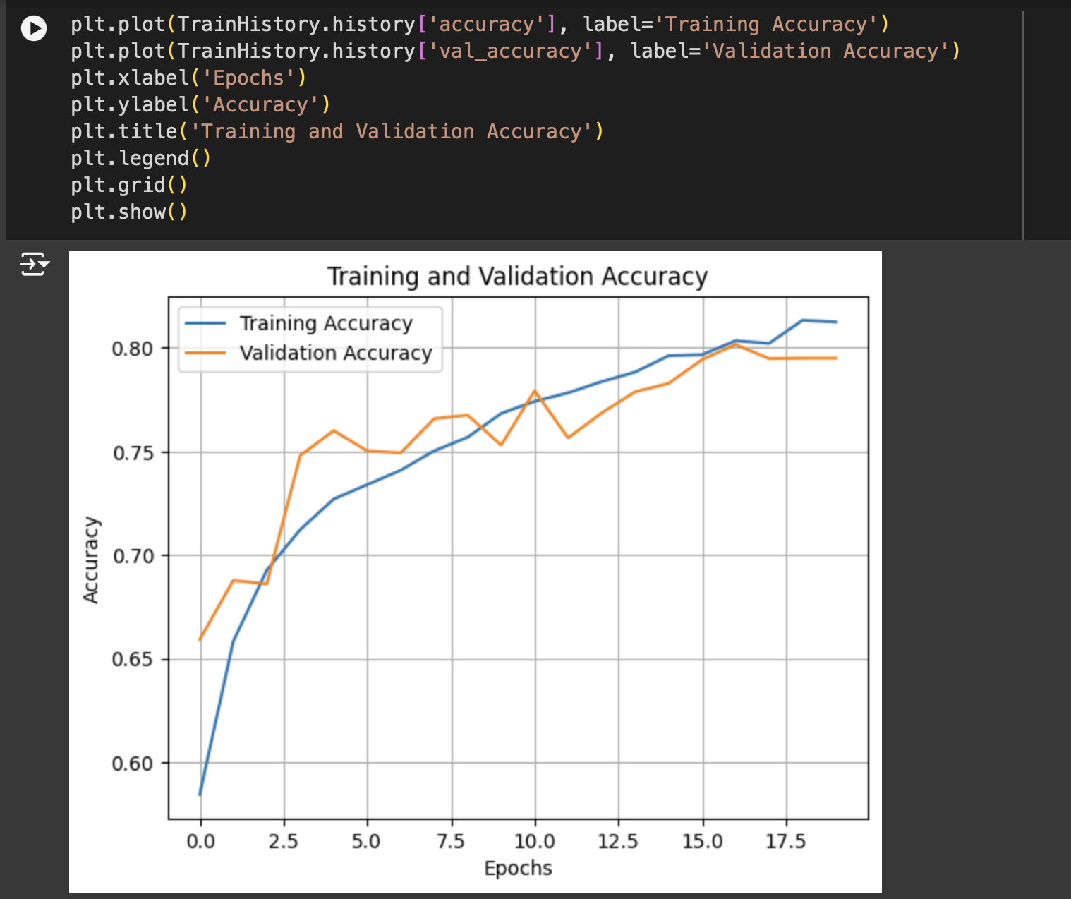
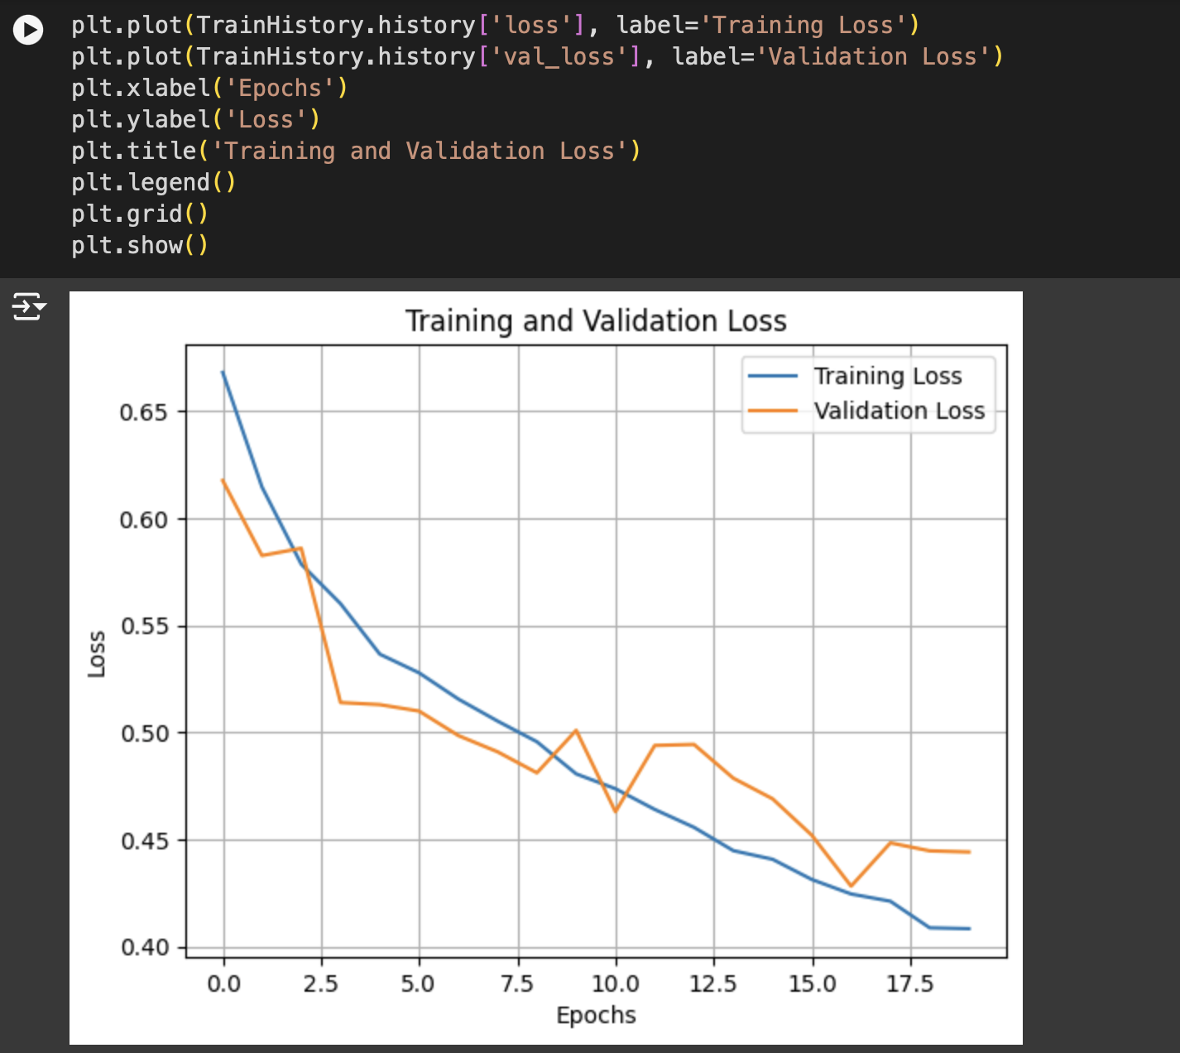
Visualisations
From ‘No of Epochs vs Accuracy’ Plot we depict that as number of epochs are increasing Training and Validation Accuracies are also increasing gradually
We can also depict that these two accuracies are almost same in all epochs
Similarly we can also see the same pattern in ‘No. of Epochs vs Loss’ Plot but loss is inversely proportional to no. of epochs

Slide 20
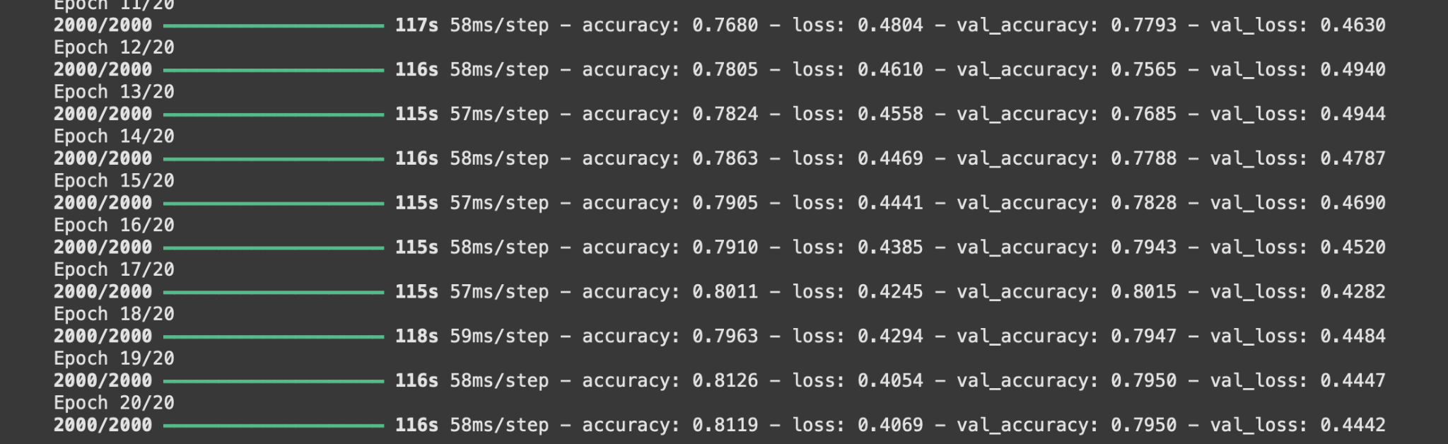
Visualisations
At the end of 20th Epoch we can see that Training and Validation accuracies are around 80% indicating the model is not overfit and underfit
We can also depict that defined learning rate of 0.001 is quite good for our architecture
In overall we can conclude that the model is well efficient in learning the underlying relationships among image features during training

Slide 21
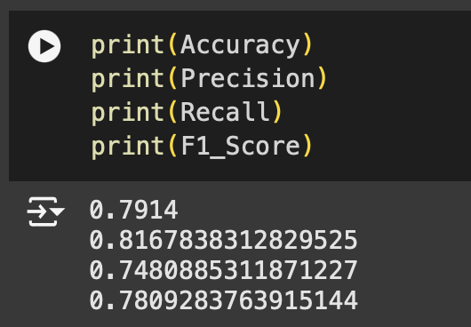
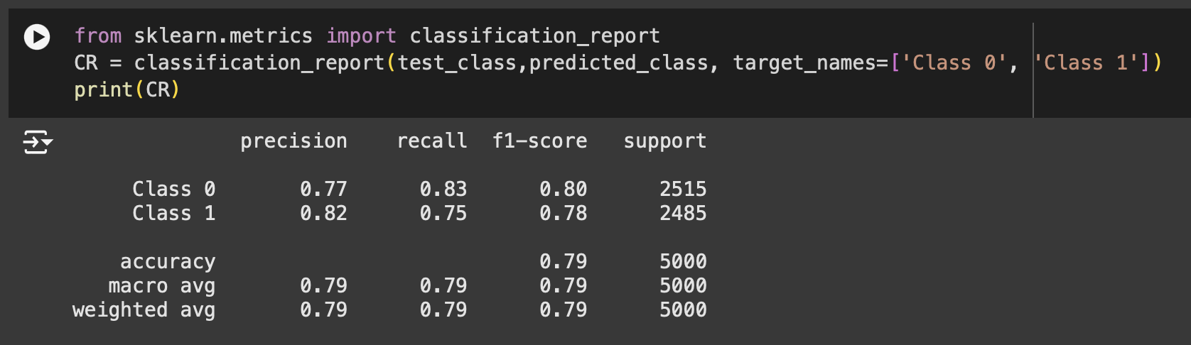
Visualisations
We can see that all metric scores are greater than 75% depicting that Our proposed CNN model is well efficient in classifying the test images to its respective class ‘1:Dog’ and ‘0:Cat’.
We can also check that test instances are almost equal indicating the data is balanced, and the performance values are also not skewed by the imbalance.

Slide 22
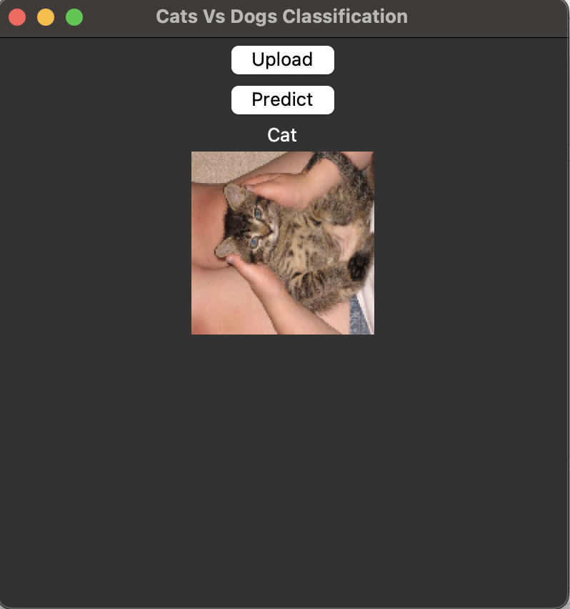
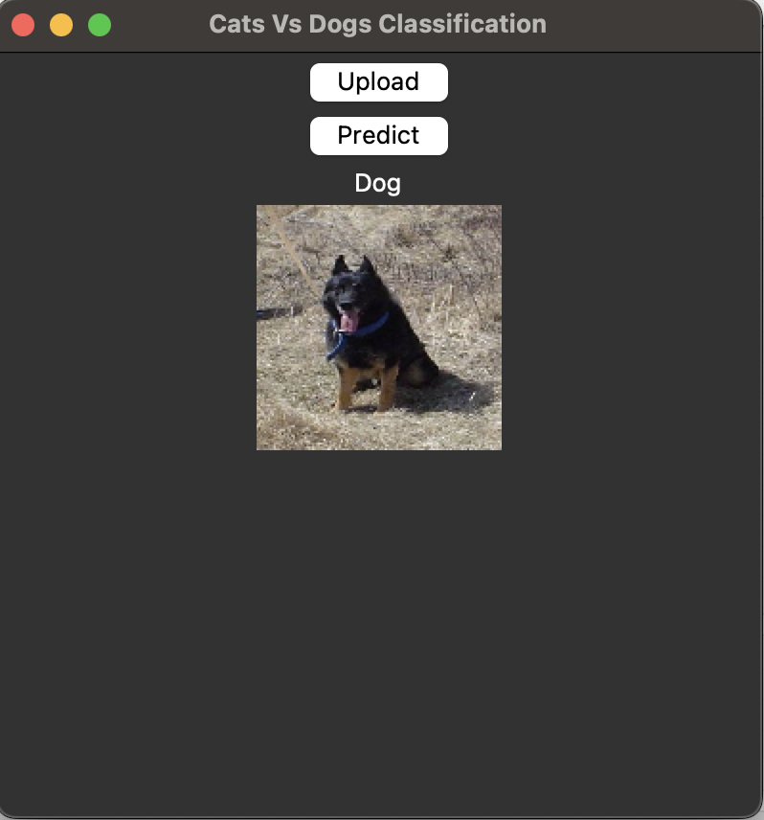
Predictions
When we click upload button, it asks to upload the Image and displaying on the screen.
When we click the predict button, it is invoking prediction function and returning the classified result as ‘Cat or Dog’
We can conclude from above results that our designed GUI is well efficient in interacting with the functionalities, displaying the image and class results.

Slide 23
Challenges Faced
There are Hardware Constraints where CPU is taking long time for training and GPU has limited computing resources
Finding optimal values for learning rate, dropout for training based on our architecture
Finding right number of Convolutional, pooling, dense layers, neurons required for training with our dataset
Finding Efficient loss function and optimizer for classification task
Handling Overfit and Underfit Issues by checking loss and accuracy curves.

Slide 24
Key Learnings
Mastering data preprocessing techniques such as augmentation, normalization, and resizing to enhance model generalization.
Building and training the model with Keras and TensorFlow highlighted the importance of optimizing hyperparameters and monitoring accuracy to balance underfitting and overfitting.
The evaluation of performance metrics, including precision, recall, and F1-score, reinforced the understanding of model effectiveness.
Deploying the model via a user-friendly GUI using Tkinter demonstrated practical skills in integrating deep learning models with interactive applications.

Slide 25
Future Enhancements
Implement Pre-Trained CNN models such as VGG16, VGG19, RESNET50 and fine tuning with our dataset to get higher performances
Adding More number of Convolutional layers and filters helps us to capture more details in our architecture
Using Ensemble techniques where we combine multiple deep learning architectures based on our classification task and dataset.
Improvement of GUI Structure by adding more components and Graphical features such as colors.
Packaging GUI and Model file together using pyinstaller and creating single executable file which is easily portable between systems.

Slide 26
Conclusion
The project successfully developed a CNN-based model for classifying cats and dogs with high efficiency
Designed a GUI for seamless interaction and intuitive image classification
Achieved ~80% training and validation accuracy with a balanced dataset.
Key metrics (accuracy, precision, recall, F1-score > 75%) validate the model's effectiveness.
Demonstrated a robust approach to image classification using deep learning.
Highlighted the importance of data preprocessing, model tuning, and deployment.

Slide 27
References
[1].GeeksforGeeks. (2023, February 3). Python | Image Classification using Keras. GeeksforGeeks.
[2].Kumar, R. (2024, November 30). Building and Using a Convolutional Neural Network (CNN) for Image Classification with Keras and TensorFlow. Medium.
[3].Devansh. (2024, November 20). Image Classification Using CNN with Keras & CIFAR-10. Analytics Vidhya.
[4].microsoft/cats_vs_dogs · Datasets at Hugging Face. (2023, September 19).
[5].Dogs vs. Cats. (n.d.). Kaggle.
[6].GeeksforGeeks. (2024, June 19). Python Tkinter. GeeksforGeeks.
[7].Ajay. (2024, January 22). Deploying deep learning model using Tkinter and PyInstaller. Analytics Vidhya.

Slide 28
THANK YOU!!

